Slide 1
Asymmetric Cryptography III
Elliptic-curve cryptography, part 1

Slide 2
Elliptic curves adaptation
The asymmetric cryptography algorithms based on the discrete logarithm problem can be adapted to work with elliptic curves, RSA cannot
 | Key exchange | Encryption | Signature | Principle | Compatiblity with elliptic curves
1) Diffie-Hellman (DH) | ✔ |  |  | Discrete logarithm problem | ✔ (ECDH)
2) Elgamal encryption | (✔) | ✔ |  | „
3) Elgamal signature |  |  | ✔ | „ | (✔) no practical relevance
4) Digital signature algorithm (DSA) |  |  | ✔ | „ | ✔ (ECDSA)
5) Rivest–Shamir–Adleman (RSA) | (✔) | ✔ | ✔ | Prime numbers factoring | x

Slide 3





Recap: Diffie-Hellmann
In Diffie-Hellmann a mutual key (usable for symmetric encryption) is created by exchange of certain information
Public domain parameters
ALICE
Modulus: $p=23$ (prime)
Generator: $g=5$(primitive root modulo $p$)
BOB
$a≔4$ (Alice‘s secret integer)
$$A≔g^{a} mod p=8$$
Shared secret $s$: $$s=B^{a} mod p=18={(g^{b} mod p)}^{a} mod p$$
$b≔3$ (Bob‘s secret integer)
$$B≔g^{b} mod p=10$$
Shared secret $s$: $$s=A^{b} mod p=18={(g^{a} mod p)}^{b} mod p$$

Slide 4
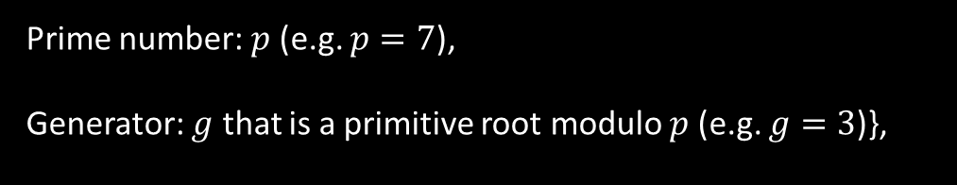



Fundamentals: cyclic groups
Diffie-Hellmann is based on the discrete logarithm problem in certain cyclic groups ${\left(ℤ_{p}\right)}^{x}$, defined by:
a | $$g^{a}$$ | $$A≔g^{a} mod p$$
1 | 3 | 3
2 | 9 | 2
3 | 27 | 6
4 | 81 | 4
5 | 243 | 5
6 | 729 | 1
7 | 2187 | 3
8 | 6561 | 2
9 | … | …
$A≔g^{a} mod p, a∈ℕ$,
Prime number: $p$ (e.g. $p=7$),
Generator: $g$ that is a primitive root modulo $p$ (e.g. $g=3$)},
(g is a primitive root modulo p if it creates a cyclic group A of period (p-1))

Slide 5

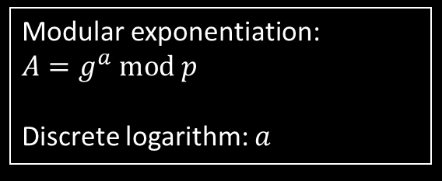
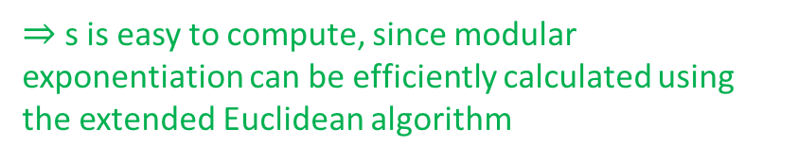
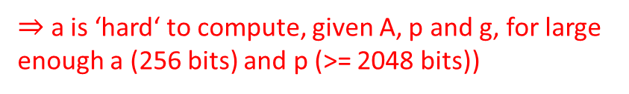
Recap: discrete logarithm problem
The discrete logarithm is ‘hard’ to compute and modular exponentiation is ‘easy’ to compute ‘one-way function’
Public domain parameters
Definitions
ALICE
Modulus: $p=23$ (prime)
Generator: $g=5$(primitive root modulo $p$)
Modular exponentiation: $$A=g^{a} mod p$$
Discrete logarithm: $a$
$a≔4$ (Alice‘s secret integer)
$$A≔g^{a} mod p=8$$
Shared secret $s$: $$s=B^{a}=18={(g^{b} mod p)}^{a} mod p$$
$⇒$ a is ‘hard‘ to compute, given A, p and g, for large enough a (256 bits) and p (>= 2048 bits))
$⇒$ s is easy to compute, since modular exponentiation can be efficiently calculated using the extended Euclidean algorithm

Slide 6



Elliptic curve cryptography - ECC
ECC is based on a discrete logarithm problem on subgroups of elliptic curves instead of on a cyclic group ${\left(ℤ_{p}\right)}^{x}$
a is ‘hard‘ to compute, given A, p and g, for large enough a (256 bits) and p (>= 2048 bits))
d is ‘hard‘ to compute, given G and Q and a proper elliptic curve
Cyclic group
$$A=g^{a} mod p$$ $a∈ℕ$
$p$prime number
$g$ is primitve root modulo $p$
Elliptic curves
$$Q=d⋅G$$
d is a secret integer, “$⋅$“ is scalar multiplication operator on elliptic curve, G and Q are points on elliptic curve,
etc ….
We will now look into all this in more detail ☺

Slide 7
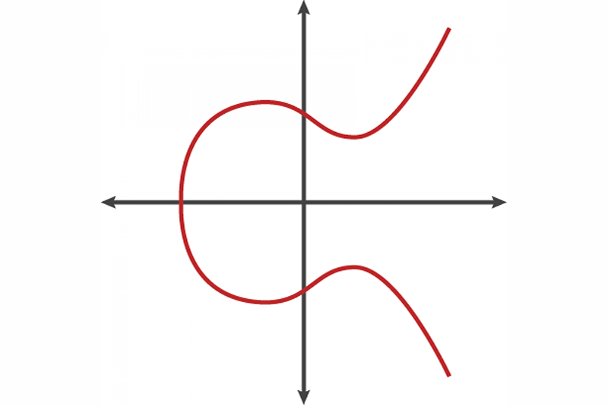
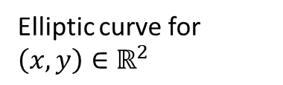




Elliptic curves
Elliptic curves are the sum of points $(x,y)$ that satisfy the equation:
$$y$$
Elliptic curve for $\left(x,y\right){∈ℝ}^{2}$
$y^{2}=x^{3}+ax+b$,
$$4a^{3}+27b≠0$$ Examples
secp256k1 (Bitcoin, Ethereum etc.): $a=0$, $b=7$
Graph on the right: $a=−1$, $b=1$
$$x$$

Slide 8





Elliptic curves – point addition
Point addition on an elliptic curve (“$+$“):
$$y$$
Elliptic curve for $\left(x,y\right){∈ℝ}^{2}$
$$P+Q=R$$
$$Q$$
$$−R$$
$$P$$
$$x$$
$$R=P+Q$$

Slide 9





Elliptic curves – scalar multiplication
Scalar multiplication on an elliptic curve (“$⋅$“):
$$y$$
Elliptic curve for $\left(x,y\right){∈ℝ}^{2}$
$−2$P
$$P$$
$$P+P=2⋅P$$
Tangent @ $P$
$$x$$
$$2P$$

Slide 10



Elliptic curves – scalar multiplication
Scalar multiplication on an elliptic curve (“$⋅$“):
$$y$$
Elliptic curve for $\left(x,y\right){∈ℝ}^{2}$
$−2$P
$$P$$
$$P+P=2⋅P$$
$$3⋅P=2⋅P+P$$
…
$$3P$$
$$x$$
$$−3P$$
$$2P$$

Slide 11




Elliptic curves – point at infinity
Point doubling of two vertical points yields point at infinity
$$𝒪$$
$$y$$
Elliptic curve for $\left(x,y\right){∈ℝ}^{2}$
$P+Q=𝒪$ (point at infinity)
$$Q$$
$$x$$
$$P$$

Slide 12


Elliptic curves over finite fields
In fact, elliptic curves for cryptography are defined over finite fields ${(ℤ_{p})}^{2}$, not $ℝ^{2}$
The elliptic curve is therefore defined as:
$$y^{2}≡x^{3}+ax+b (mod p)$$
The blue dots resemble the elliptic curve now constrained between 0 and p
The yellow line resembles the point addition of points A and B:
$$A+B=C$$

Slide 13


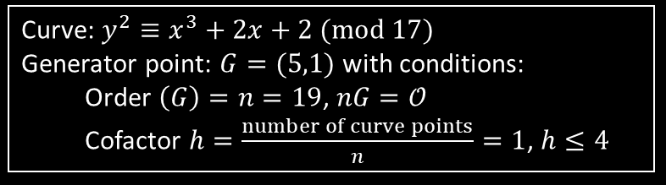
Elliptic curve Diffie Hellmann - ECDH
First, the public domain parameters are agreed upon by Alice and Bob
Public domain parameters
ALICE
Curve: $y^{2}≡x^{3}+2x+2 (mod 17)$
Generator point: $G=(5,1)$with conditions:
Order $\left(G\right)=n=19$, $nG=𝒪$ Cofactor $h=\frac{number of curve points}{n}=1$, $h≤4$
BOB
Picks secret integer $a≔3$, $1≤a≤n−1$
Calculate Point $A=a⋅G=(10,6)$
Shared secret point $P$: $$P=a⋅B=a⋅b⋅G=(13,7)$$
Picks secret integer $b≔9$, $1≤b≤n−1$
$$\text{Calculate} \text{Point} B=b⋅G=(7,6)$$
Shared secret point $P$: $$P=b⋅A=b⋅a⋅G=(13,7)$$

Slide 14
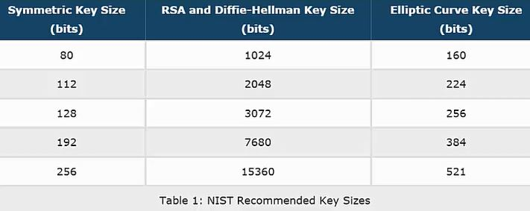
Comparison of key sizes
In elliptic curve cryptography, smaller key sizes can be used for same level of security. The effect scales with the security level.
Key size factor
6.4
12
29.5

Slide 15
Drawbacks of ECC
Backdoor: ECC has not been mathematically proven to be intractable. Certain elliptic curves might have a backdoor. Especially the curves suggested by NIST that were developed at NSA are under suspicion.
Patents: Some elements in ECC are patented, e.g. Blackberry holds a number of patents
Quantum attack: ECC might be more susceptible to quantum attacks than RSA, i.e. Shor‘s algorithm…
…

Slide 16
Next time: ECDSA
The asymmetric cryptography algorithms based on the discrete logarithm problem can be adapted to work with elliptic curves, RSA cannot
 | Key exchange | Encryption | Signature | Principle | Compatiblity with elliptic curves
1) Diffie-Hellman (DH) | ✔ |  |  | Discrete logarithm problem | ✔ (ECDH)
2) Elgamal encryption | (✔) | ✔ |  | „
3) Elgamal signature |  |  | ✔ | „ | (✔) no practical relevance
4) Digital signature algorithm (DSA) |  |  | ✔ | „ | ✔ (ECDSA)
5) Rivest–Shamir–Adleman (RSA) | (✔) | ✔ | ✔ | Prime numbers factoring | x

